Slide 1


Simulation of Research-Grade Physics, Chemistry, and Engineering Experiments in LabVIEW as a Flexible Template for Remote Laboratories
47th SEFI Annual Conference, Budapest University of Technology and Economics
Dr Richard James Lewis¹ and Professor Timothy David Drysdale²
¹ School of Physics and Astronomy, Cardiff University, United Kingdom ² School of Engineering, The University of Edinburgh, United Kingdom
18th September 2019

Slide 2
Motivation

Slide 3
Why simulations? Why remote laboratories?
Cardiff University School of Physics and Astronomy
Rapidly increasing numbers of MSc students
Research-group style, community-based teaching model
Award-winning, authentic project-based learning
Capacity and modality
Community space accommodates 50 students maximum
MSc teaching laboratory capacity 20 students maximum
Full-time only (12 months), strong demand for part-time
Mandatory project-based element in core modules
Targets
Increased capacity: additional MSc programmes, CDTs
Widened participation: part-time and remote learning
Authenticity: preserve what makes a Cardiff MSc special
AY | MScs | Students
2012/13 | 1 | 2
2013/14 | 1 | 2
2014/15 | 1 | 7
2015/16 | 3 | 14
2016/17 | 2 | 22
2017/18 | 5 | 21
2018/19 | 5 | 24
2019/20 | 6 | 40
2020/21 | 6 | 45 (est.)
2021/22 | 7 | 50 (est.)

Slide 4
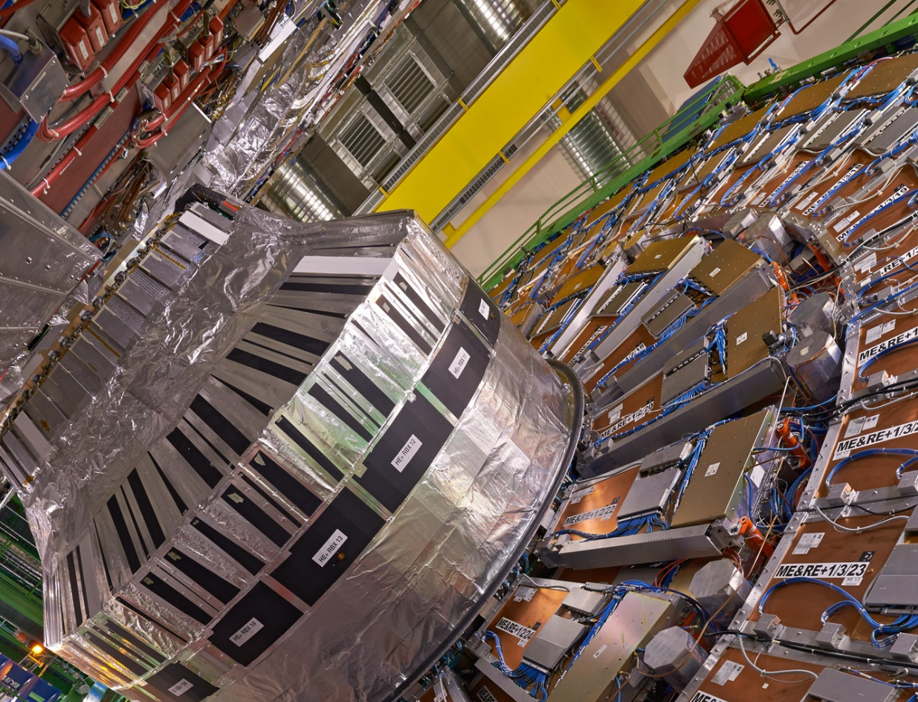
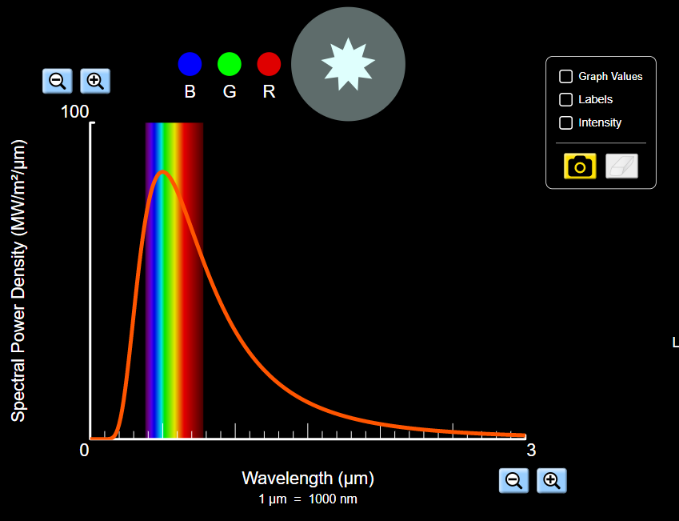
An opportunity: the gap between simulation regimes
Research regime
Scale: every physical, instrumental scale
Complexity: highly bespoke, complex
Context: iterative, with experiment
Availability: research group only
Source code: in group, quality variable
Ease of use: not always user friendly!
Authenticity: represents “real science”
Educational regime
Scale: very broad range, but narrow-focus
Complexity: simple, fundamental concepts
Context: conceptual, early undergraduate
Availability: easy, public, commercial
Source code: open and closed source
Ease of use: friendliness prioritised
Authenticity: subordinated to friendliness
Credit: CERN
https://phet.colorado.edu/sims/html/blackbody-spectrum/latest/blackbody-spectrum_en.html
Gap identified: authentic research-based simulations for virtual laboratories

Slide 5
Our proposal:
1. Bridge the gap between the research and educational regimes
2. Exploit in-house simulations and control software

Slide 6
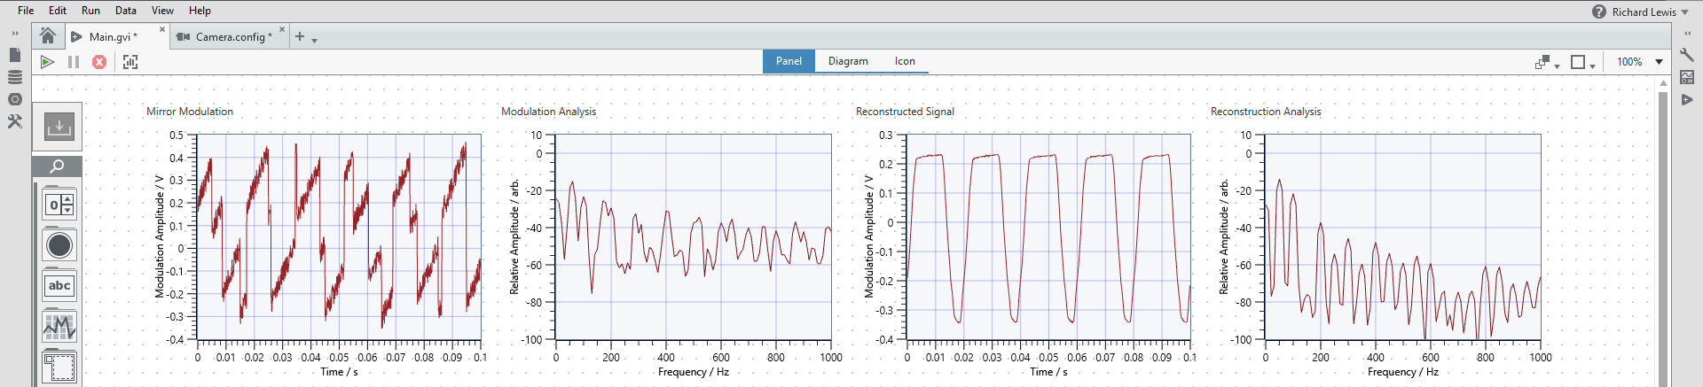
General authentic educational simulation requirements
Modularity and user interaction
Timescale compatibility
Time budgeting configurability
Adjustable complexity
Realism
Appropriate use of affordances
Easily implemented in LabVIEW
Specific to operational context

Slide 7
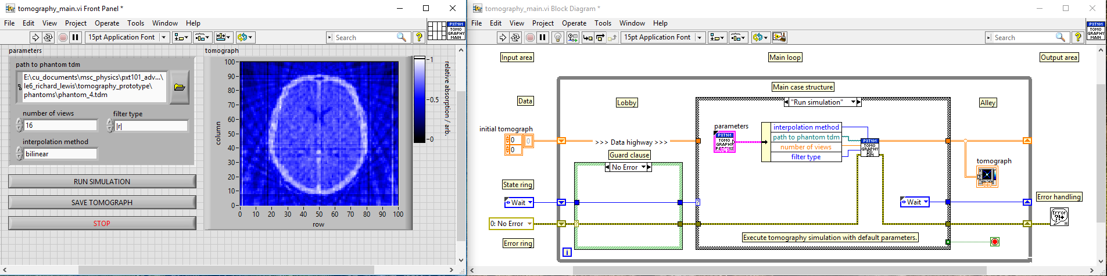
Why use LabVIEW?
Things to bear in mind…
Ubiquity
Inherent parallelism
Rapid GUI development
Can embed Python and MATLAB
Authentic user experience
Existing code possibly poor
Parallelism has its own issues
Research GUIs possibly terrible
Repurposing takes significant time
Software needs accompanying resources

Slide 8
Implementing a modular simulation in LabVIEW
<example BD showing threads, link to TILO version closely>

Slide 9
Proof-of-concept: a simulation of the TILO experiment

Slide 10
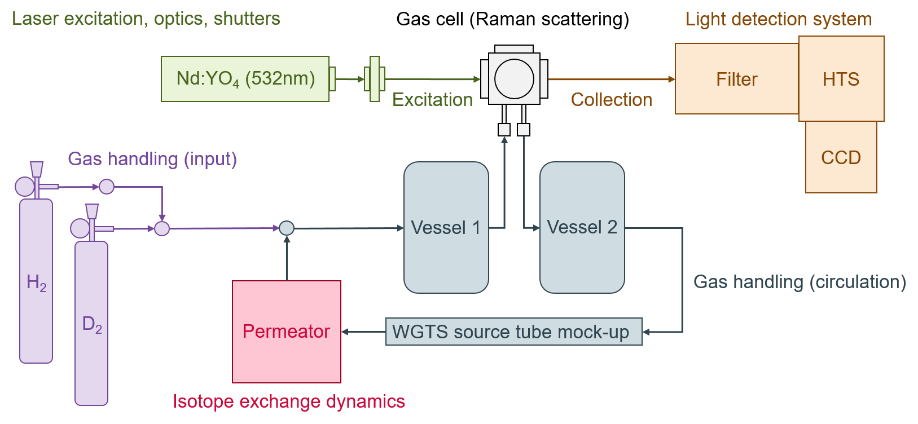
Simulation of TILO: principal simulation elements
Element
Raman scattering
Gas handling systems
Permeator vessel
Light detection system
Laser excitation
Safety infrastructure
UI monitoring
Time budgeting
Adapted from: R. J. Lewis et al., (2008), Laser Phys. Lett., Vol. 5, No. 7, P: 522, https://doi.org/10.1002/lapl.200810026

Slide 11
Simulation of TILO: principal simulation elements
Element
Raman scattering
Gas handling systems
Permeator vessel
Light detection system
Laser excitation
Safety infrastructure
UI monitoring
Time budgeting
Complexities
Scattering model depth, polarisation
Connectivity model, diffusion, equilibration
Isotope exchange dynamics, temperature
Transmission efficiency, noise, aberrations
CW laser line shape, warm-up, mode hops
Interdependence of simulation elements
Implementation of simulated failures
Synchronising to dominant timescale (>1s)
Timescale
10⁻¹⁴ to 10⁻¹³s
10⁻³ to 100s
1 to 100s
1 to 1000s
1 to 5000s
>10⁻⁶s
Asynchronous
Asynchronous
Real-time?
No
Yes
Yes
Yes
Yes
No*
N/A
N/A
LabVIEW
Formula node / files
Custom SubVI (map)
Formula node
2D Arrays of DBL
User-defined waveform(s)
Boolean logic
Event structure
FGV / files

Slide 12
Simulation of TILO: multiple loop architecture
Element
Raman scattering
Gas handling systems
Permeator vessel
Light detection system
Laser excitation
Safety infrastructure
UI monitoring
Time budgeting
Loopy BD, linked to earlier diagram

Slide 13
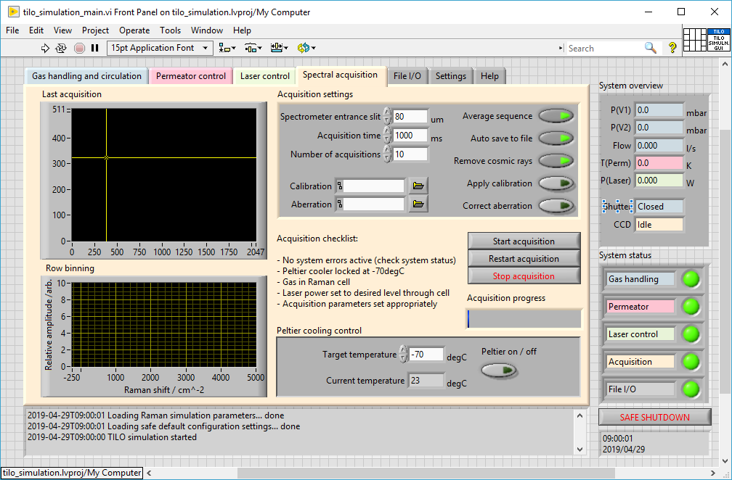
Simulation of TILO: an authentic user interface
Element
Raman scattering
Gas handling systems
Permeator vessel
Light detection system
Laser excitation
Safety infrastructure
UI monitoring
Time budgeting

Slide 14
Operational contexts and extension to remote laboratories

Slide 15
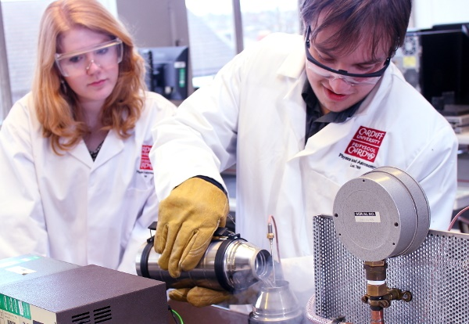
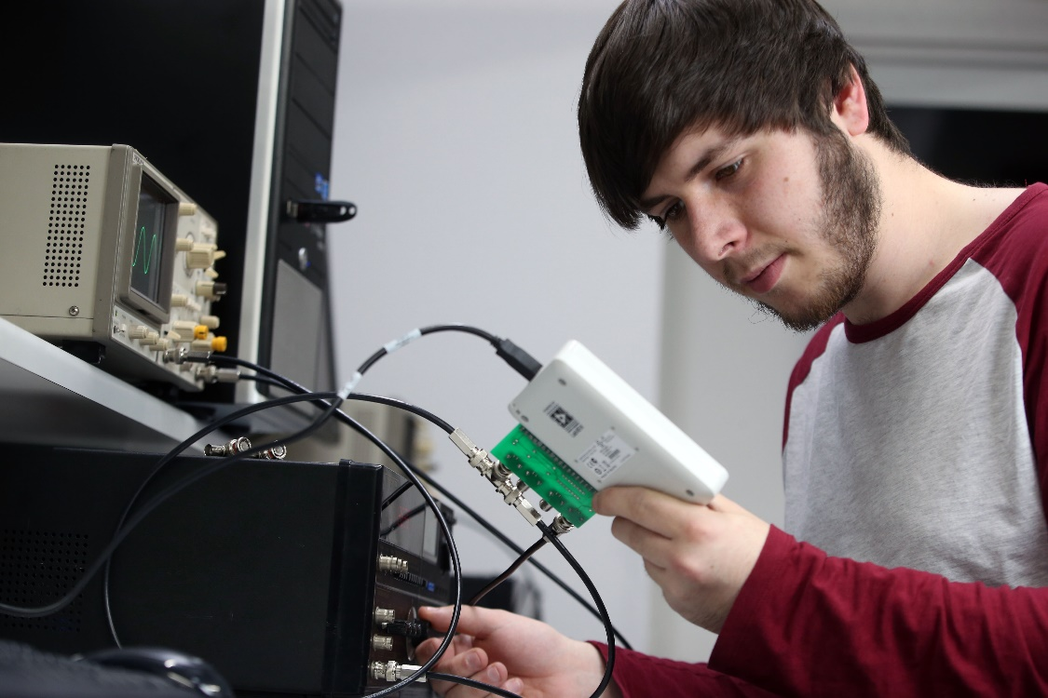
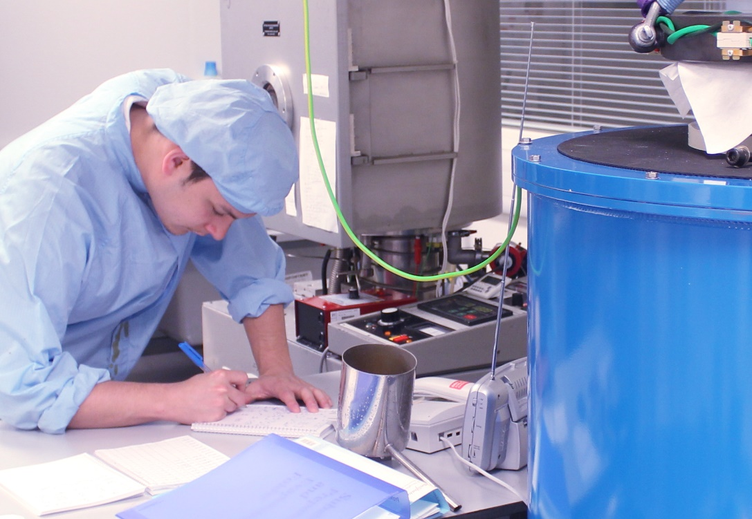
Operational contexts for realistic laboratory simulations
BSc problem-based learning
Instant results
Individual / paired working
Concepts focus:
Spectroscopy
Gas dynamics
S/N optimisation
MSc project-based learning
Instant results, time budget
Small group working
Investigation focus:
Unknown gas mixtures
System characterisation
Booby traps(!)
PhD student training
Real-time operation
Context-specific working
Realism focus:
Local protocols
Safety and logging
Feasibility testing
Undergraduate (BSc) problem-based learning
Postgraduate (MSc) project-based learning
Research student (PhD) training

Slide 16
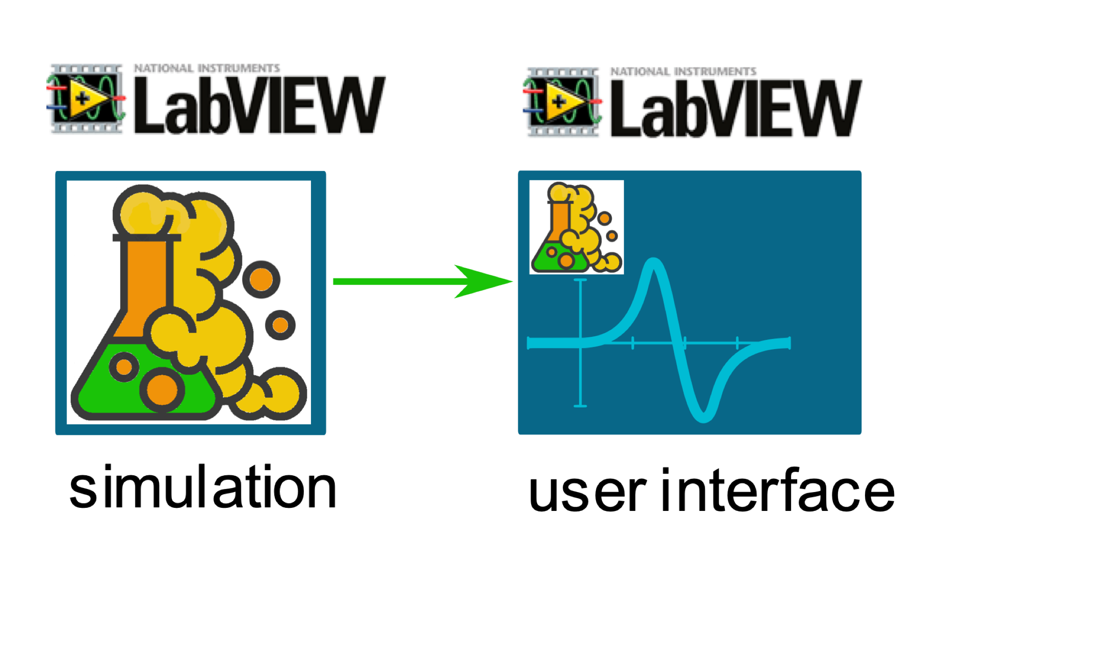
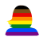
Local users rely on tightly-coupled application & user interface

Slide 17
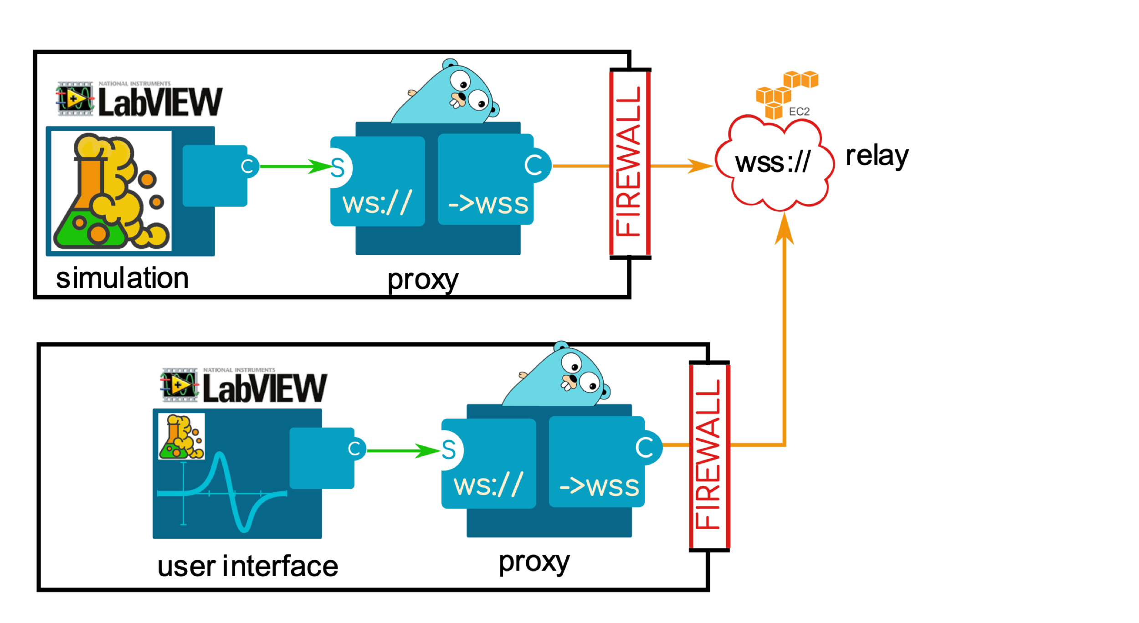
Remote users require a secure connection over network

Slide 18
Remote users require a secure connection over network

Slide 19
Remote users require a secure connection over network
*Automatic
connection
management key to sustainable operation

Slide 20
Summary
A gap has been identified in the educational application of simulations
We propose to repurpose research-grade simulations and control software
Proposal adaptable to different operational contexts: UG, MSc, training
Major gains in authentic experience in a robust and scalable pattern
Extensible and scalable in principle to large-scale remote laboratories
Major potential gains, but requires significant development effort

Slide 21
Contact details
<put Tim’s and my details here>

